Slide 1
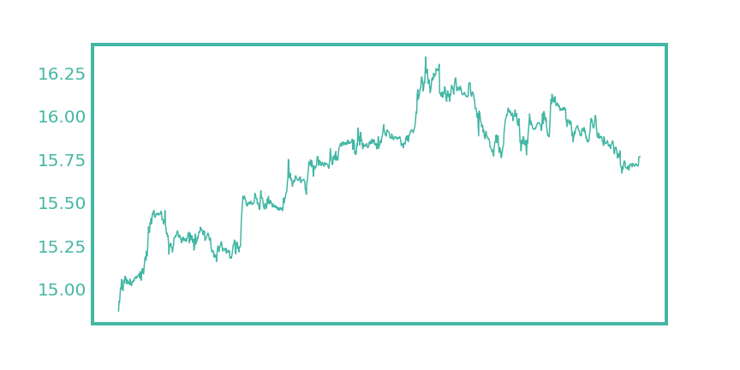
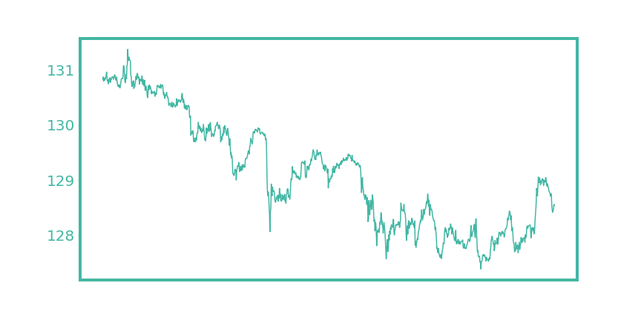
Last Update: 9 Dec 2021 17:51
Top 5
Bottom 5
Name | Last Price | Change | % Change
USD/ZAR | 15.7678 | 0.0545 | +0.35%
USD/THB | 33.459 | 0.115 | +0.34%
USD/PHP | 50.393 | 0.173 | +0.34%
USD/INR | 75.55 | 0.195 | +0.26%
USD/RUB | 73.6453 | 0.1587 | +0.22%
Name | Last Price | Change | % Change
EUR/JPY | 128.545 | -0.442 | -0.34%
EUR/USD | 1.1322 | -0.0022 | -0.19%
USD/MYR | 4.215 | -0.008 | -0.19%
EUR/GBP | 0.857 | -0.0015 | -0.18%
USD/JPY | 113.57 | -0.167 | -0.15%
USD / ZAR
EUR / JPY

Slide 2
I love Hunter Bevis solve my problem today!!!

